Slide 1

HospitalQ
Business Plan

Slide 2
Mission Statement
Domain – Health Care:-
When planning a dinner out don’t you check yelp and other websites to find the best restaurant?
Similarly, shouldn’t you do the same to check the quality of the hospitals you rely on when you need medical care?
In an emergency, your situation may depend on getting to the nearest hospital.
So our team mission is to help provide the customers for their solutions - Hospital Info in one click.

Slide 3
Project Summary
HospitalQ will provide users an invaluable information about hospitals nearby
Hospitals not just nearby but the specialty & best care and treatment for their condition.
Provide reports that show how well these hospitals treat certain conditions.
When your life is at risk we are here to help you make the most informed decision.

Slide 4
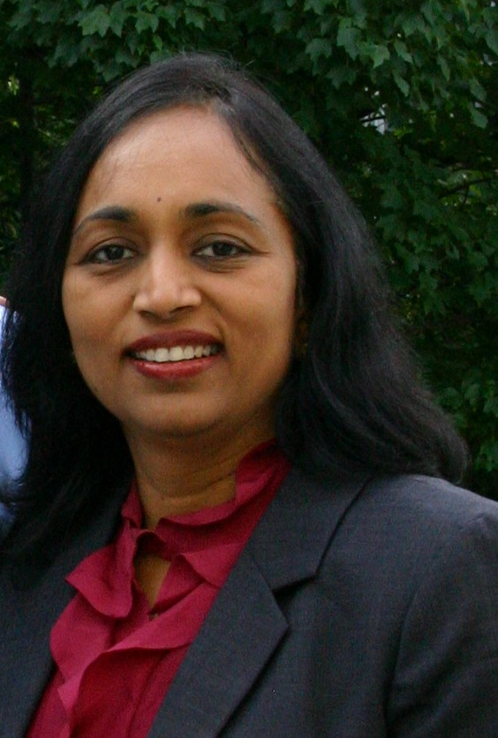
Nirmala Sundararaman
Software Engineer with over 10 years of experience in software development in object-oriented and web development technologies and databases. Highly proficient in all areas of software development cycle.
Currently, Lead developer developing web applications using J2EE skills and struts framework in a treaty compliance project. Her responsibilities include requirement analysis, software and database design, implementation, testing and deployment to production.
Truly amazed how large volume of data can be processed so quickly. Would love to work in projects using BigData – Hadoop technology.

Slide 5
The Team
Deepika - Hive, Sqoop
Nirmala – Pig, Hive
Mohasin – Flume, Sqoop
Devanand – Pig, QlikView

Slide 6
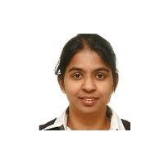
Deepika S. Pandian
Proven track record as a Manager & Team Lead, have developed and deployed various complex database applications over Eighteen years for multiple companies. Highly proficient in Requirements Development, Object-Oriented Design and Analysis within the full life cycle of the software design process.
Right now architecting and implementing enterprise level network penetration testing and vulnerability management/remediation of military and civilian government networks.
Have lots of passion to work with various Databases, started with Visual Foxpro, MS Access, Oracle, MySQL, MS SQL Server, SQLite and now turning that passion into BigData – Hadoop technology.

Slide 7



Input (Traditional Resources)

Slide 8


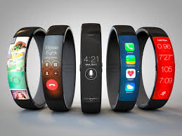




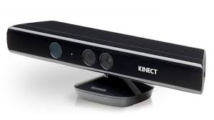

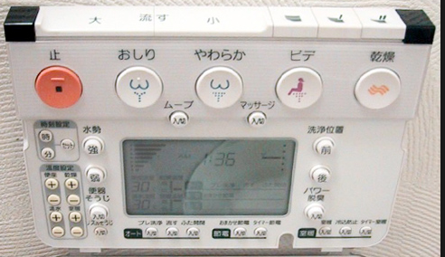


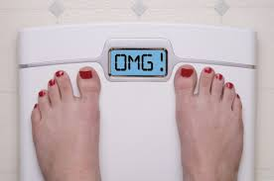





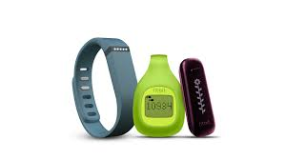
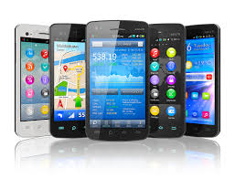
Input (Unstructured/Big Data)
Various Big Data Resources

Slide 9
Input for HospitalQ
CSV Files – using Hive
MySQL – using Sqoop
Live Stream (Twitter Data) - Flume

Slide 10

Input -> Process
Loaded data into HDFS
hadoop fs –put /home/cloudera/hospitalq/datafiles/hospitalinfo.csv /user/cloudera/hospitalq/datafiles/
Created table in HDFS using Hive
create table hospitalmaster (providerID string,hospitalName string,streetName string,city string,state string,zipcode string,countyName string,phoneNumber string,hospitalType string,hospitalownership string, emergencyServices string) row format delimited fields terminated by ",";
Loaded HDFS Files into Hive
LOAD DATA INPATH '/user/cloudera/hospitalq/datafiles/hospitalinfo.csv' OVERWRITE INTO TABLE hospitalmaster;

Slide 11
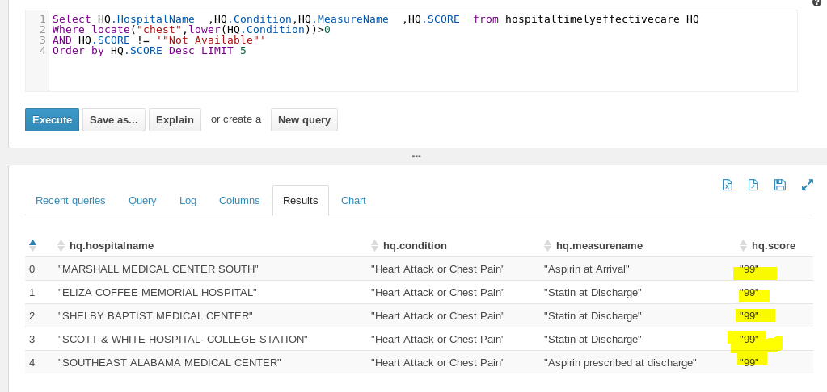
Sample output from Hive

Slide 12

Another Input Process - Sqoop
Moving MYSql data into HDFS using Sqoop
sqoop import --connect jdbc:mysql://localhost/sep2015class --username sdeepika --password 12345 --table hospital -m 1 --target-dir /user/cloudera/deepika ;
Moving MYSql data into Hive directly using Sqoop
sqoop import --connect jdbc:mysql://localhost/sep2015class --username sdeepika --password 12345 --table hospital -m 1 --hive-import --hive-table hospitalDB.hospital;

Slide 13
Datasets
Description
Hive database
hospitalmaster
hospitalcompare
hospitalopvolume
hospitalreadmit
hospitaltimelyeffectivecare

Slide 14

Apache Pig
Pig is a platform to for analyzing large datasets using a high-level and expressive language called Pig Latin which enables users to describe data-processing steps.
The Pig compiler converts these steps into a series of MapReduce programs that are executed in the Hadoop platform.
Pig is used to do complex processing making it ideal for three categories of Big Data Jobs:
Extract-transform-load (ETL) data pipelines,
Research on raw data, and
Iterative data processing

Slide 15
Loading data using Pig Storage
> pig
grunt> HMaster = LOAD '/user/hive/warehouse/healthq.db/hospitalmaster' USING PigStorage(',') AS (providerID:chararray, hospitalName:chararray,streetName:chararray,city:chararray,state:chararray,zipcode:chararray,countyName:chararray,phoneNumber:chararray,hospitalType:chararray,hospitalownership:chararray,emergencyServices:chararray);
dump HMaster;

Slide 16
Sample Pig Script
Finding out if given a zip code (75087) which hospitals have emergency services:
zipResult = FILTER HMaster by zipcode =='75087' AND emergencyServices == 'Yes';
dump zipResult;
(670097,BAYLOR EMERGENCY MEDICAL CENTER,1975 ALPHA STE 100,ROCKWALL,TX,75087,ROCKWALL,2142946200,Acute Care Hospitals,Proprietary,Yes)

Slide 17
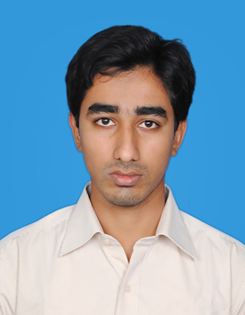
Mohasin B.E, M.S
Recent Graduate in Computer Science at Wright State University, Ohio.
Highly motivated young professional and a skilled Software Engineer endeavoring to engage in a creative career.
Proficient in Object Oriented Programming, Structure Query Language, and Software Development Cycle methodologies.
Passionate about learning Data Mining, Cloud Computing, and new technologies have landed me at Big Data, were I have dedicated my time on playing around with Hadoop Components.

Slide 18
Design Architecture 1
Clusters
MySQL – DB(Sqoop)
Live Stream(Flume)
CSV(Pig)
HDFS
QlikView/Tableau to display output

Slide 19
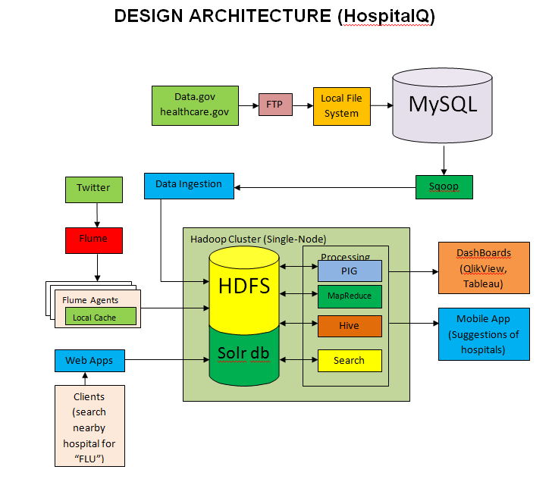
Design Architecture 2

Slide 20

Apache Flume (Streaming Data)
Service for efficiently collecting, aggregating, and moving large amounts of streaming data into Hadoop Distributed File System (HDFS)
Architecture is simple with source, channel, and distribution
Internal components include flume configuration, weblogs from were the data being populated, and HDFS

Slide 21
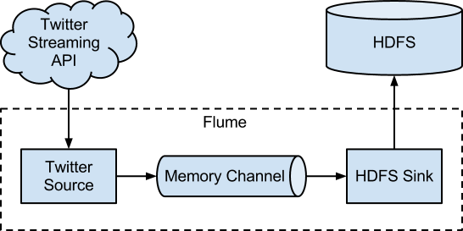
Flume Architecture

Slide 22
Twitter Data
Our idea is to get live stream data using keywords like sick, flu, hospital, emergency, health center, cold, fever, and add any related health conditions
Streaming this live data directly into HDFS, then to make the data valuable by processing through other components of Big Data like MapReduce, Pig, Hive, Hbase, Spark, and other technologies
Applications: Consuming twitter API for building mobile applications, prediction analysis, behavioral patterns of a person, and actionable intelligence

Slide 23
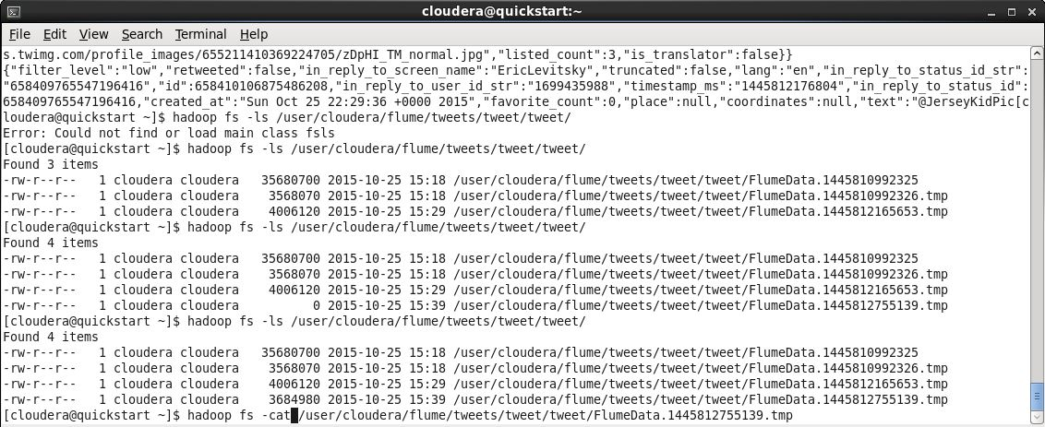
Twitter Data

Slide 24
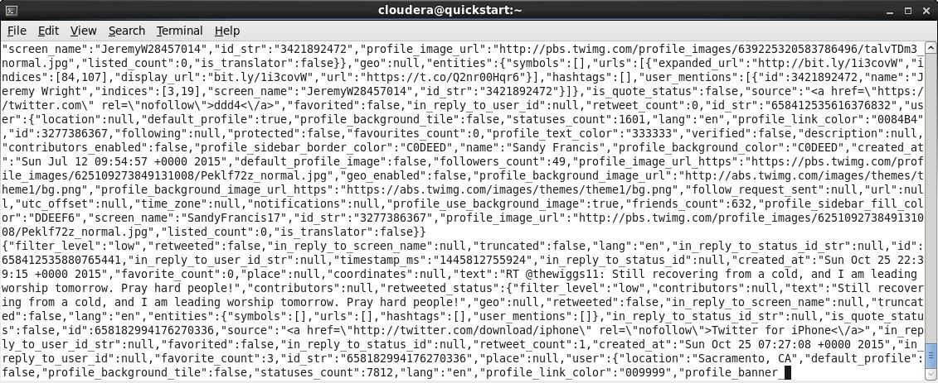
Twitter Data

Slide 25
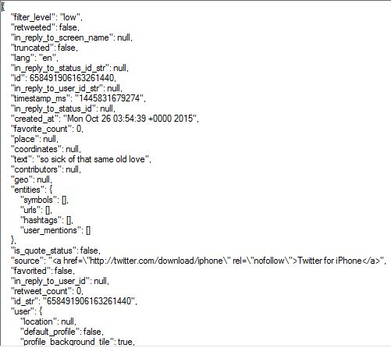
JSON (Semi-structured)

Slide 26
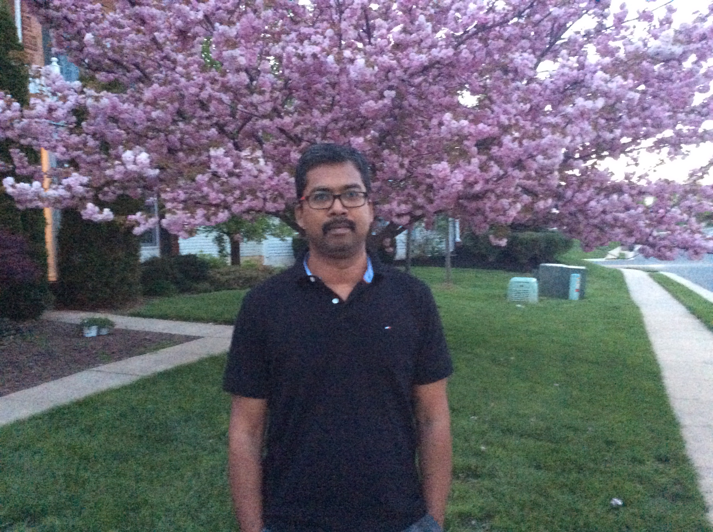
Devanand Jayapaul
Have worked as a Business Analyst in multiple domains.
Have got vast experience in dealing with clients as a business development manager.
Right now pursuing Master’s in Information Systems at Stratford University.
Passion to work on MS Access, Oracle, MySQL, MS SQL Server and turning that passion into BigData – Hadoop technology.

Slide 27
Data Analytics
Software Used:
Qlikview
QlikView is the most flexible Business Intelligence platform for turning data into knowledge.
It enables the users to easily consolidate, search, and visually analyse all their data for unprecedented business insight.
Effective decision-making is based on having the right information available and easy accessible.

Slide 28
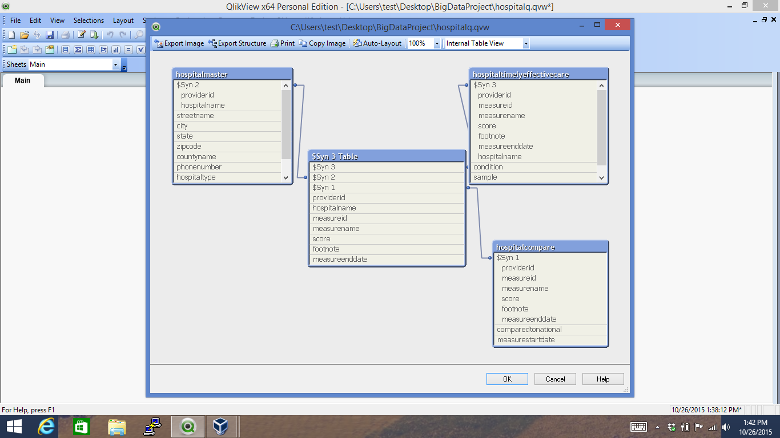

Slide 29
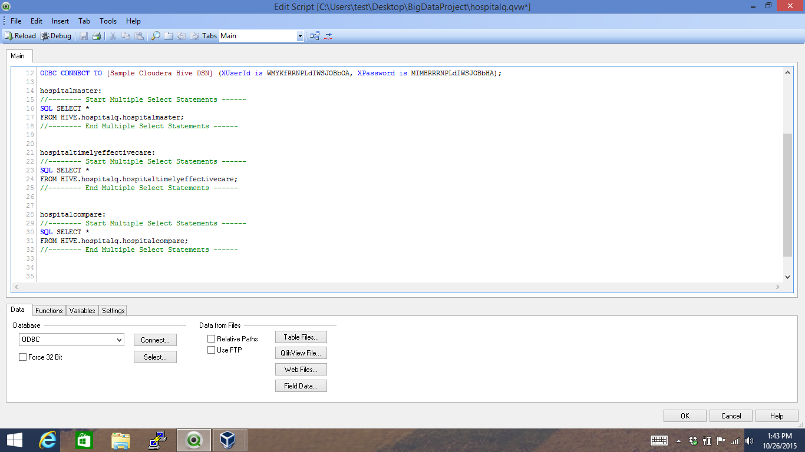

Slide 30
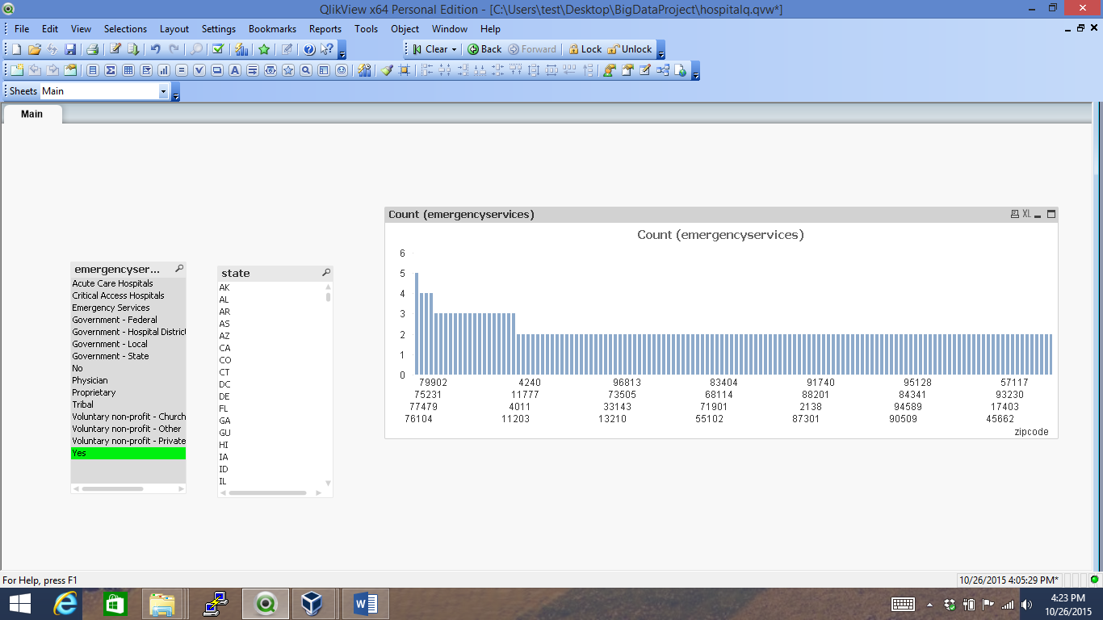

Slide 31
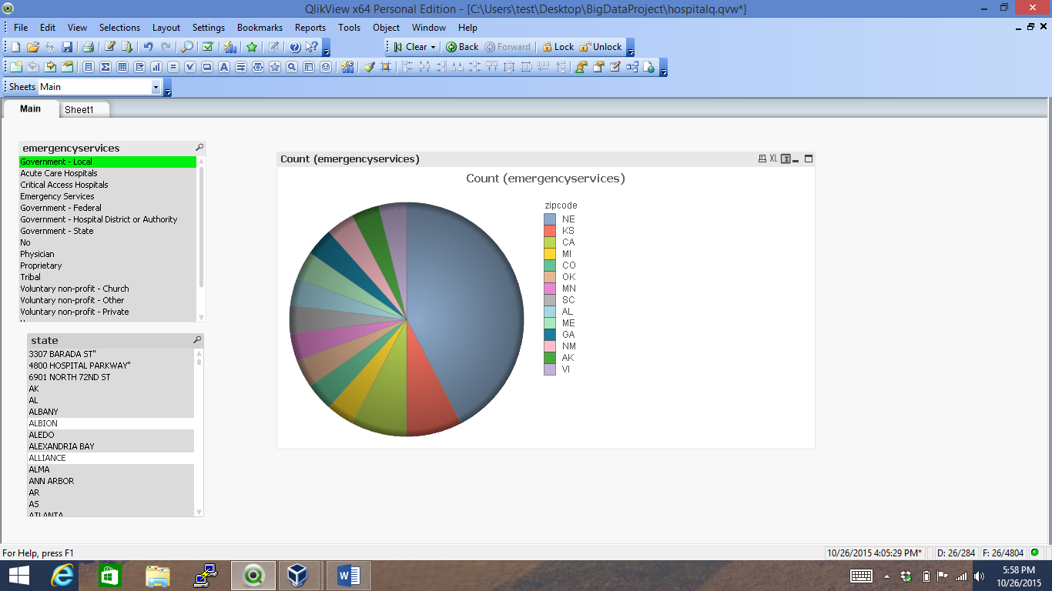

Slide 32
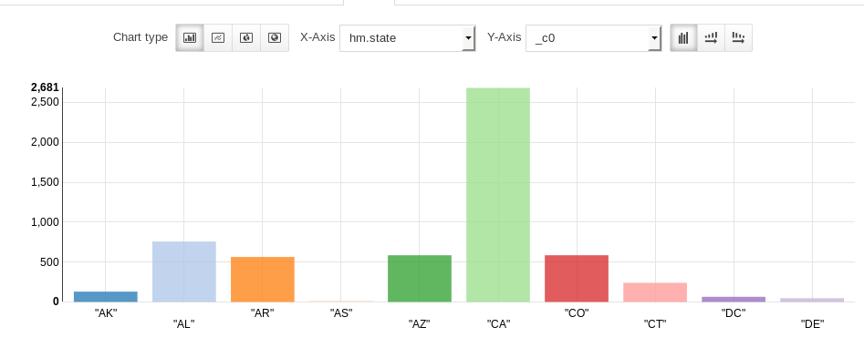

Slide 33
Value
Help the patient to get better medical service.
Very fast response
Finger tip information to everyone
Best Hospitals in a particular area for the particular condition as well can be easily identified

Slide 34
BigData Technologies Used
QlikView/Tableau
Flume
HDFS
Hive
MapReduce
MySQL
PIG
Sqoop
Solr

Slide 35
Resource Requirements
Datasets from
data.medicare.gov
Data.gov
cdc.gov
Twitter data
Other possible resources

Slide 36
Key Issues
Understanding Big Data
New technologies to be learnt & understand well
Study on Health Care Industry
SOLR, D3JS requires training
Live streaming data
Availability of our team members

Slide 37
Contact Us
Deepika S: deepika S: hideepika@gmail.com Mohasin A: amohasin.0808@gmail.com Nirmala S: nirmala.sundararaman@gmail.com Devanand J: devanandjayapaulusa@gmail.com

Slide 38


